Slide 1
Stoichiometry
Chapter 4

Slide 2
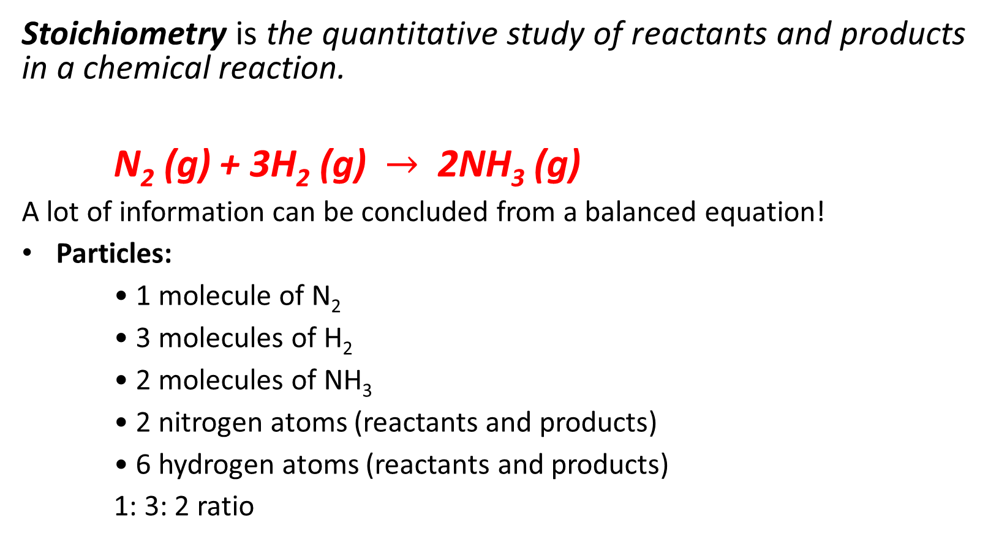
Stoichiometry is the quantitative study of reactants and products in a chemical reaction.
N₂ (g) + 3H₂ (g) $→$ 2NH₃ (g)
A lot of information can be concluded from a balanced equation!
Particles:
• 1 molecule of N₂
• 3 molecules of H₂
• 2 molecules of NH₃
• 2 nitrogen atoms (reactants and products)
• 6 hydrogen atoms (reactants and products)
1: 3: 2 ratio

Slide 3
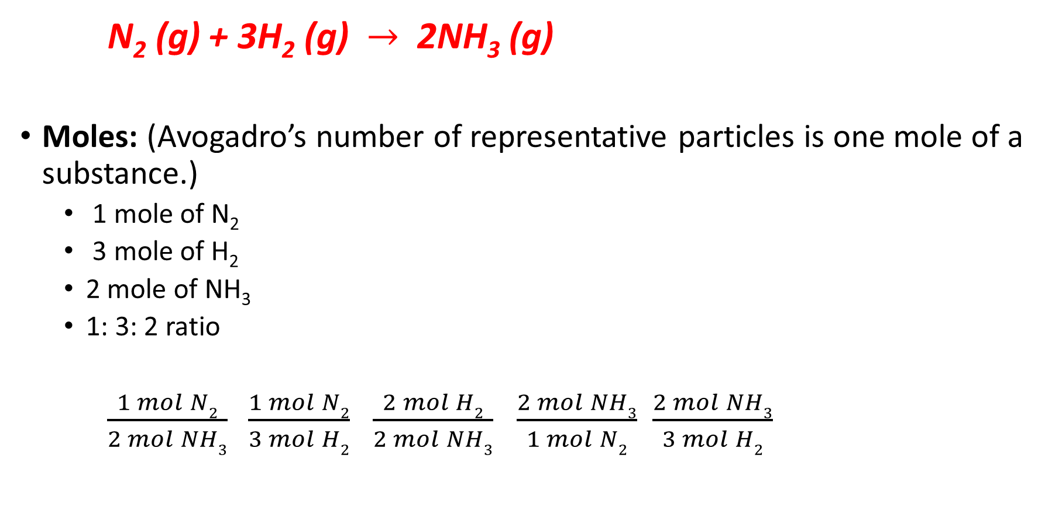
N₂ (g) + 3H₂ (g) $→$ 2NH₃ (g)
Moles: (Avogadro’s number of representative particles is one mole of a substance.)
1 mole of N₂
3 mole of H₂
2 mole of NH₃
1: 3: 2 ratio
$\frac{1 mol N2}{2 mol NH3} \frac{1 mol N2}{3 mol H2}$ $\frac{2 mol H2}{2 mol NH3}$ $\frac{2 mol NH3}{1 mol N2}$ $\frac{2 mol NH3}{3 mol H2}$

Slide 4
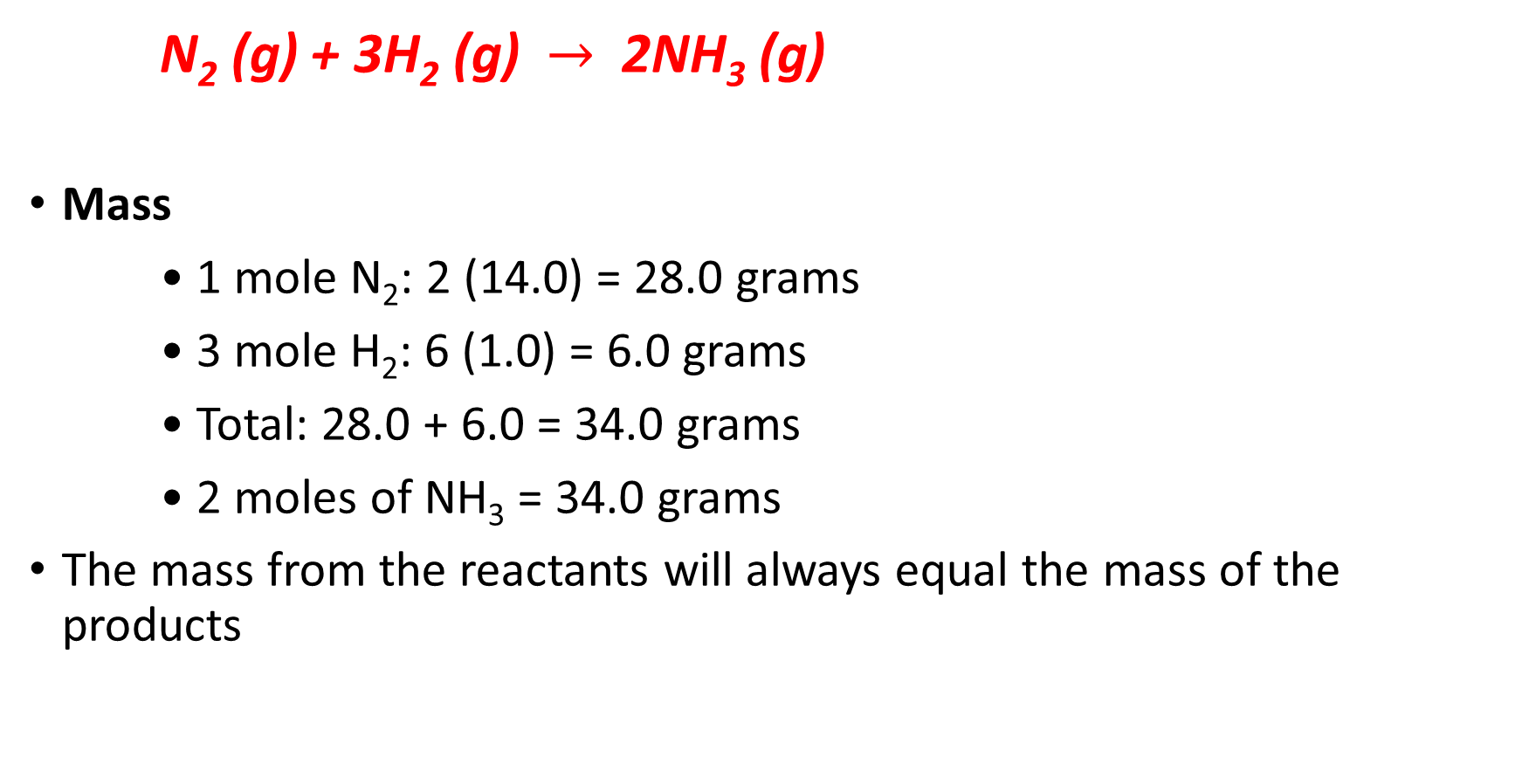
N₂ (g) + 3H₂ (g) $→$ 2NH₃ (g)
Mass
• 1 mole N₂: 2 (14.0) = 28.0 grams
• 3 mole H₂: 6 (1.0) = 6.0 grams
• Total: 28.0 + 6.0 = 34.0 grams
• 2 moles of NH₃ = 34.0 grams
The mass from the reactants will always equal the mass of the products

Slide 5
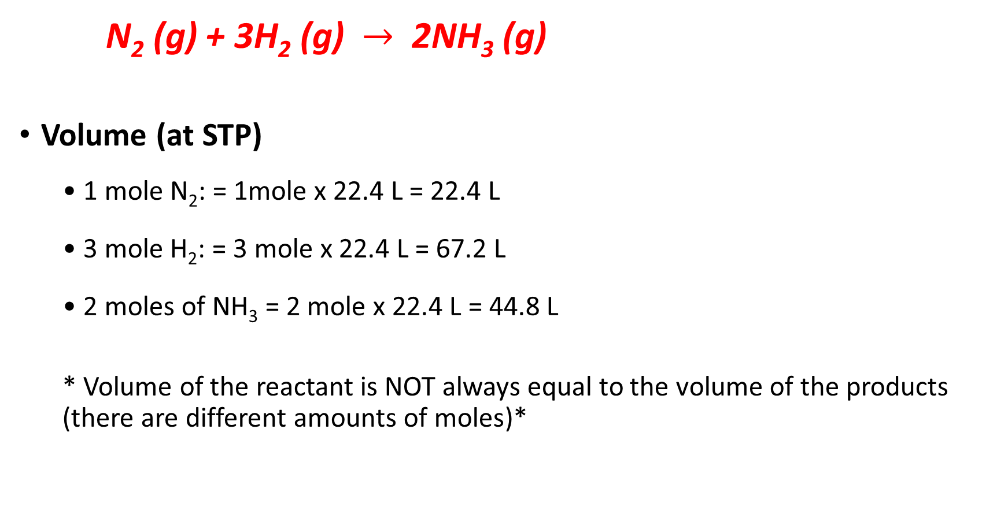
N₂ (g) + 3H₂ (g) $→$ 2NH₃ (g)
Volume (at STP)
• 1 mole N₂: = 1mole x 22.4 L = 22.4 L
• 3 mole H₂: = 3 mole x 22.4 L = 67.2 L
• 2 moles of NH₃ = 2 mole x 22.4 L = 44.8 L
* Volume of the reactant is NOT always equal to the volume of the products (there are different amounts of moles)*

Slide 6
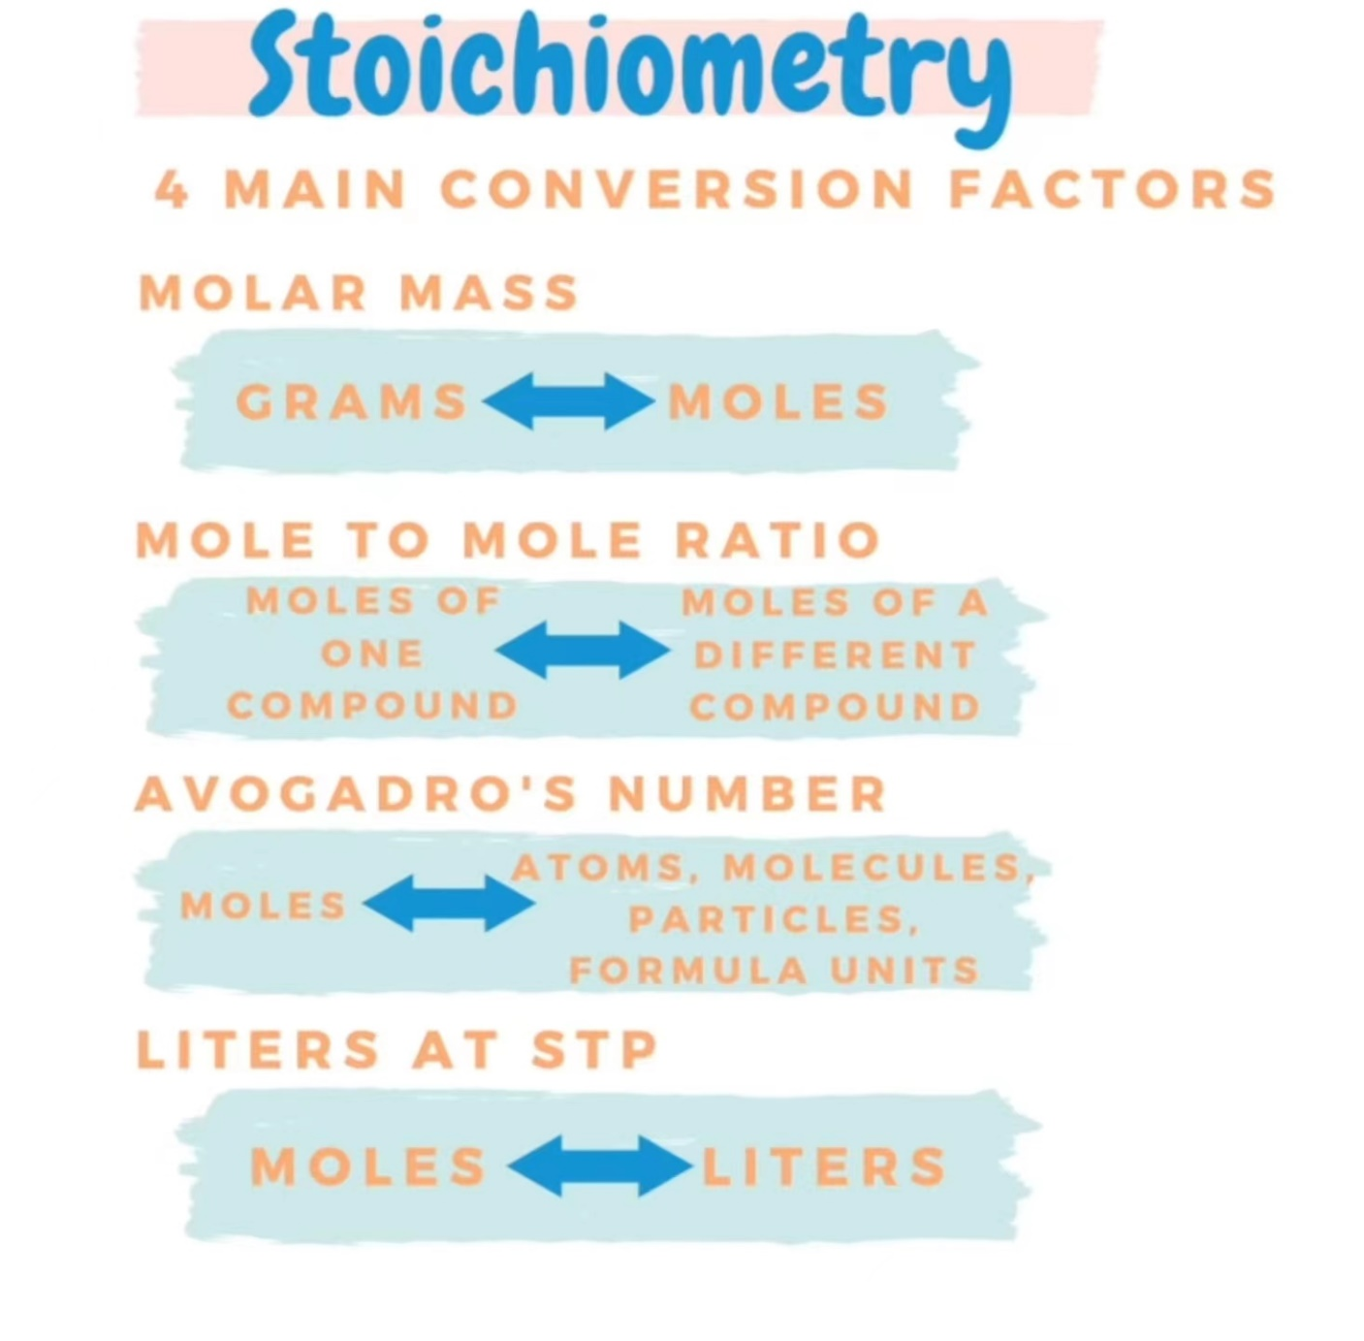

Slide 7


Mole to Mole Ratio
Calculate the number of moles of aluminum atoms that will react with 3.18 mol of oxygen molecules to form aluminum oxide.
Given: 3.18 mol of O₂ Find? mol of Al

Slide 8
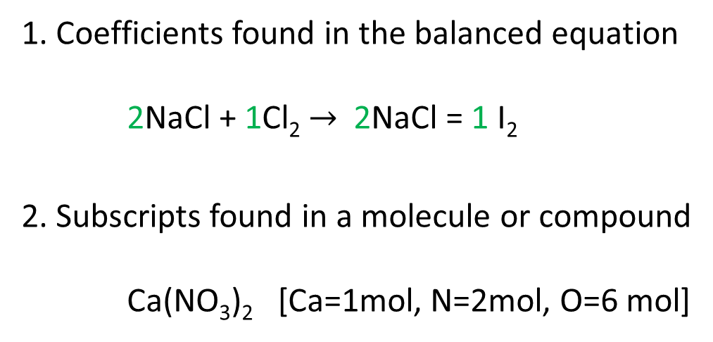

Mole to Mole Ratio
Moles of compound $→$Moles of a different compound
Moles of compound A moles of compound B
moles of compound A
Where to find mole to mole ratio?
1. Coefficients found in the balanced equation
2NaCl + 1Cl₂ $→$2NaCl = 1 I₂
2. Subscripts found in a molecule or compound
Ca(NO₃)₂ [Ca=1mol, N=2mol, O=6 mol]

Slide 9
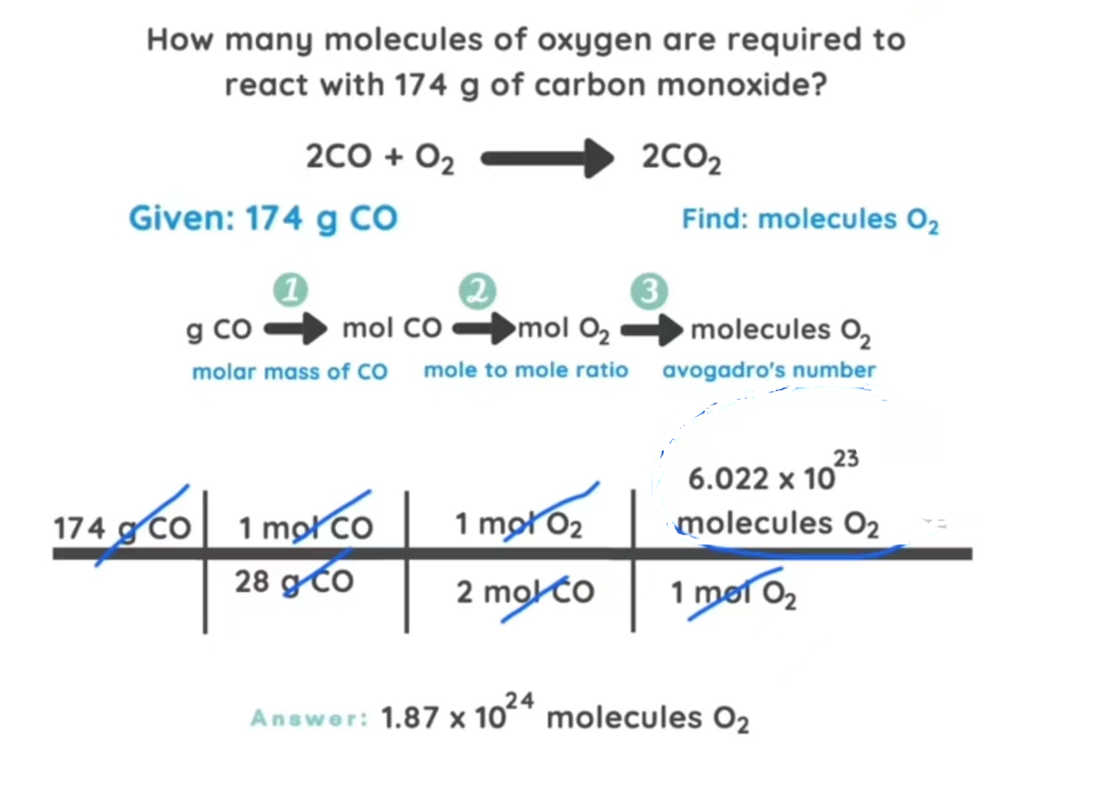

Slide 10


A general overall equation for this very complex process represents
the degradation of glucose (C₆H₁₂O₆) to carbon dioxide (CO₂) and water (H₂O):
If 856 g of C₆H₁₂O₆ is consumed by a person over a certain period, what is the mass of CO₂ produced?
Given: 856 g C₆H₁₂O₆ Find: mass (g) of CO₂

Slide 11
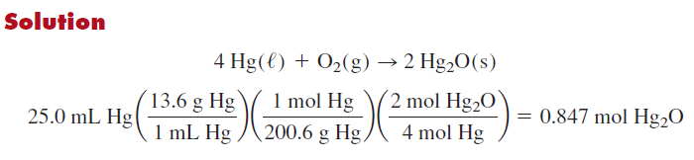
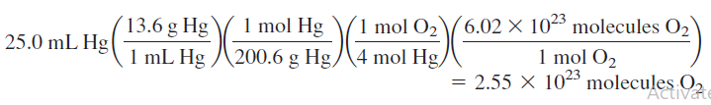
Calculate the number of moles of solid mercury(I) oxide that can be produced by the reaction of oxygen gas with 25.0 mL of liquid mercury (density =13.6 g/mL). Also, calculate the number of molecules of oxygen required.

Slide 12
Practice exercise
All alkali metals react with water to produce hydrogen gas and the corresponding alkali metal hydroxide. A typical reaction is that between lithium and water:
How many grams of Li are needed to produce 9.89 g of H₂?

Slide 13
Practice exercise
Calculate the number of metric tons of gas required to prepare 50.0 metric tons of liquid H₂SO₄. (1 MT = 1× 10⁶ g)

Slide 14

Practice exercise
Calculate the volume of liquid water (density = 1g/mL) produced by burning 48.4 g of propane gas (C₃H₈), and condensing the gaseous water produced.

Slide 15
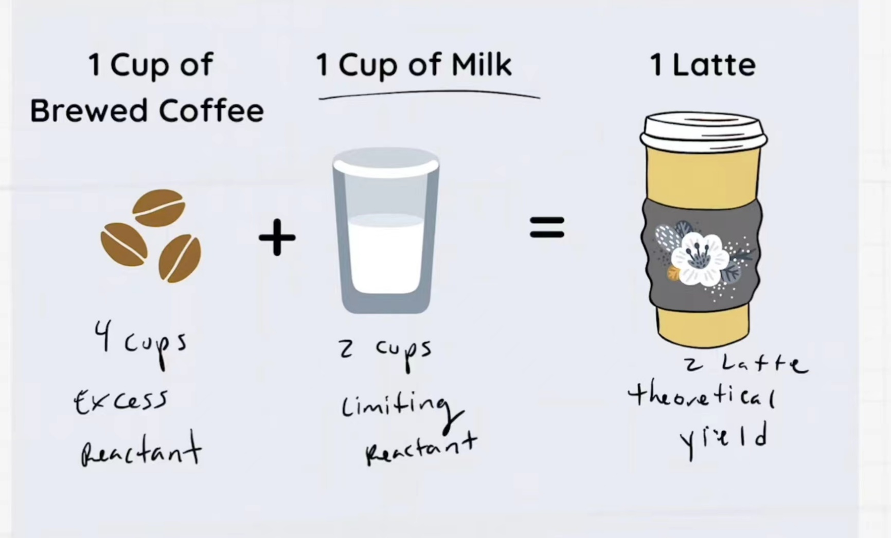
Limiting reactant (reagent)
Limiting reagent is the reactant used up first in a reaction.
Excess reagents are the reactants present in quantities greater than necessary to react with the quantity of the limiting reagent.

Slide 16
If 23 g of iron(II) chloride reacts with 41 g of sodium phosphate, what is the limiting reactant? How much sodium chloride can be formed?

Slide 17
Practice exercise
Consider the reaction: 2 H₂(g) + O₂(g) → 2 H₂O(l) If 20 grams of H₂ gas is reacted with 96 grams of O₂ gas,
Which reactant is the limiting reactant?
How much of the excess reactant remains?
How much H₂O is produced?

Slide 18
Theoretical, Actual, & Percent Yield
Theoretical Yield
The maximum amount of product calculated using the balanced equation.
The maximum amount of a given product that can be formed when the limiting reactant is completely consumed.
Actual Yield
The amount of product obtained when the reaction takes place.
The actual yield (amount produced) of a reaction is usually less than the maximum expected (theoretical yield).

Slide 19
Percent yield
The ratio of actual yield to theoretical yield.
percent yield = actual yield (g) x 100 theoretical yield (g)
To calculate the percent yield, the actual yield and theoretical yield are needed.

Slide 20
Practice exercise
2C(g) + O₂(g) 2CO(g)
What is the percent yield of CO when 30.0 g O₂ are used? The actual yield is 40.0 g CO.
theoretical yield of CO
30.0 g O₂ x 1 mol O₂ x 2 mol CO x 28.01 g CO
32.00 g O₂ 1 mol O₂ 1 mol CO
= 52.5 g CO (theoretical)
percent yield
40.0 g CO (actual) x 100 = 76.2 % yield
52.5 g CO (theoretical)

Slide 21
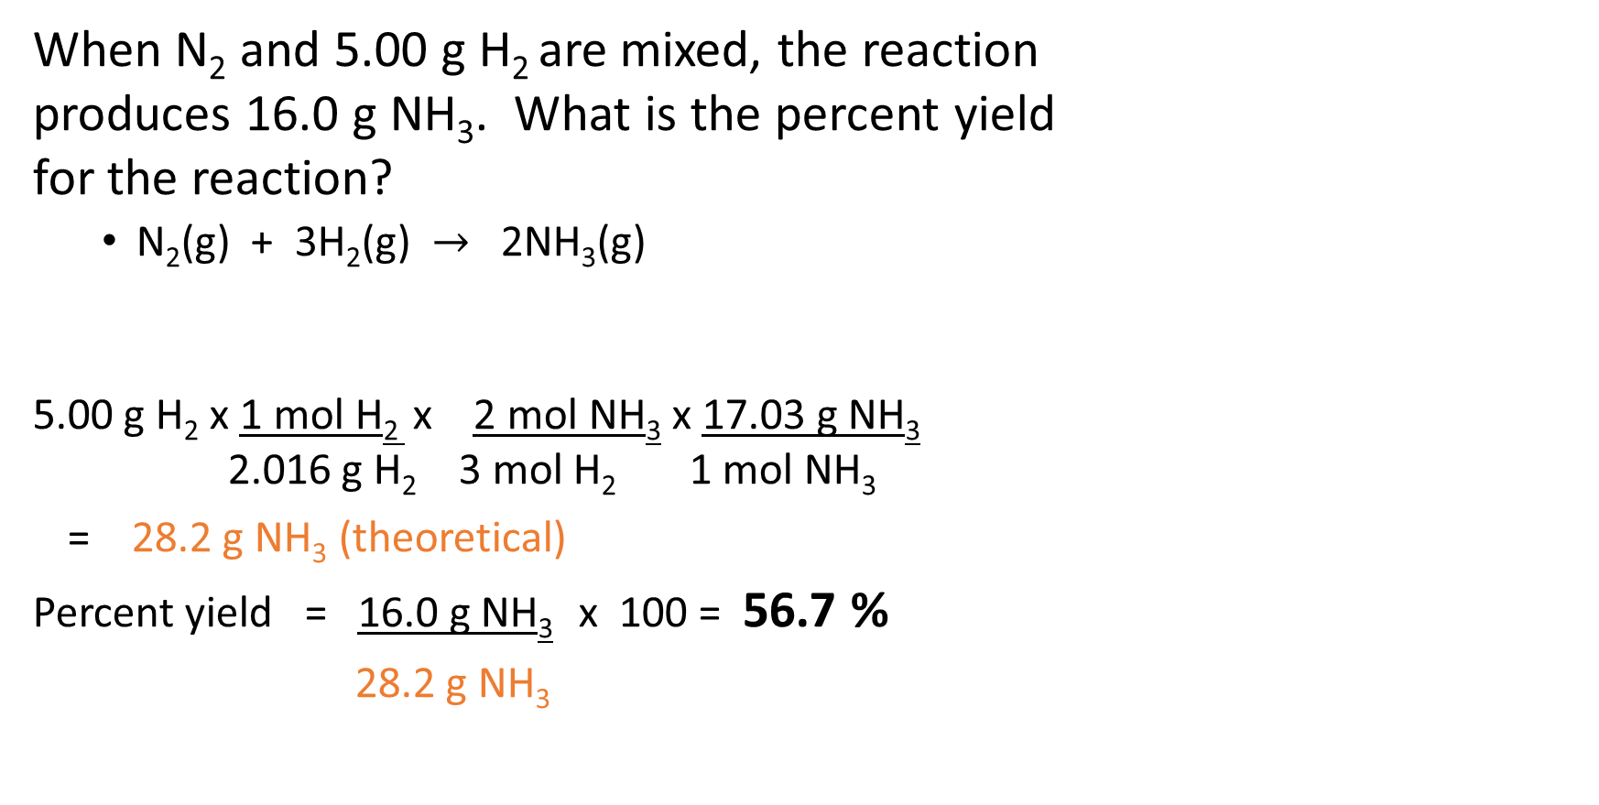
Practice exercise
When N₂ and 5.00 g H₂ are mixed, the reaction
produces 16.0 g NH₃. What is the percent yield
for the reaction?
N₂(g) + 3H₂(g) $→$ 2NH₃(g)
5.00 g H₂ x 1 mol H₂ x 2 mol NH₃ x 17.03 g NH₃
2.016 g H₂ 3 mol H₂ 1 mol NH₃
= 28.2 g NH₃ (theoretical)
Percent yield = 16.0 g NH₃ x 100 = 56.7 %
28.2 g NH₃

Slide 22
Practice exercise
Consider the following reaction:
P₄(s) + 6F₂(g) → 4PF₃(g)
What mass of P₄ is needed to produce 85.0 g of PF₃ if the reaction has a 64.9% yield?
46.1 g P₄

Slide 23
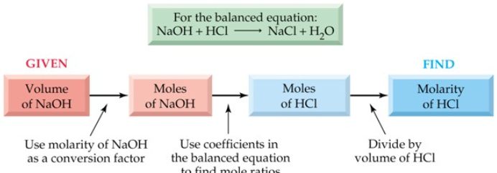
Solution stoichiometry
Solution Stoichiometry uses molarity as a conversion factor between volume and moles of a substance in a solution.
n = MV
n: moles of solute
M: molarity
V: volume

Slide 24
Practice exercise
What volume (in mL) of 0.150 Molar HCl is required to react completely with 0.503 g of dry Na₂CO₃?

Slide 25
Practice exercise
Aluminum hydroxide can be dissolved in hydrochloric acid to form aluminum chloride and water. How many mL of 3.37M HCl is needed to react with 10 g of aluminum hydroxide?

Slide 26
Titration
Titration is a technique for determining either the concentration of a solution of unknown molarity or the number of moles of a substance in a given sample.
example, acid-base titrations
In the titration, a solution of known concentration (standard solution) is added gradually to another solution (unknown concentration), until the chemical reaction between the two solutions is complete.
An indicator is used to signal the point at which the titration is stopped.

Slide 27
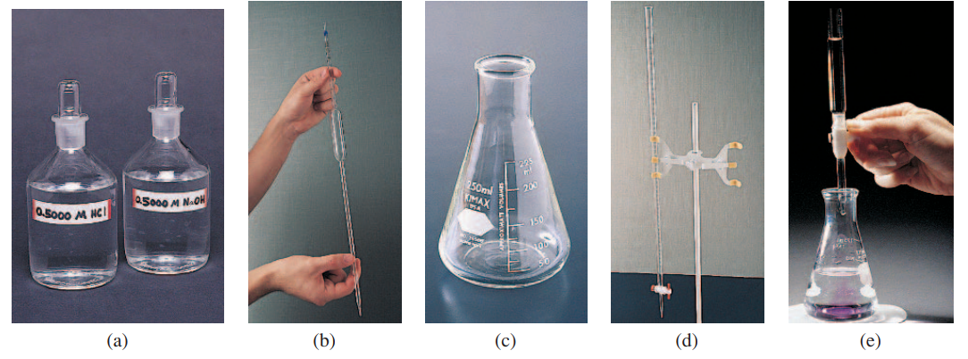
Titration
Stock solutions
Pipet
Erlenmeyer ﬂask
Buret
Reagent（indicator

